Slide 1

Face recognition
Face verification and binary classification
deeplearning.ai

Slide 2
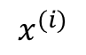

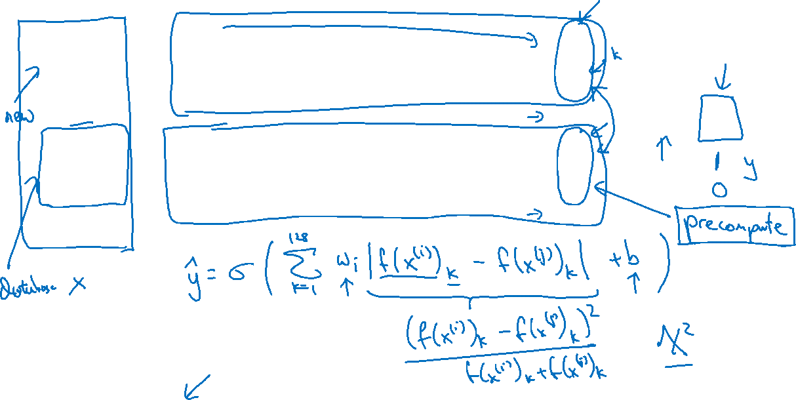
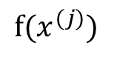

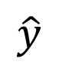
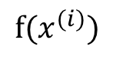
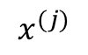
Learning the similarity function
$$⋮$$
$$x^{(i)}$$
$$f(x^{(i)})$$
$$\hat{y}$$
$$⋮$$
$$x^{(j)}$$
$$f(x^{(j)})$$
[Taigman et. al., 2014. DeepFace closing the gap to human level performance]

Slide 3
The new Employee problem
When we train the face verification network, we don't actually necessarily train it on the company's database at all, we can use any set of labeled face photos. (Per Andrew's instructions, we're looking at having say 10k different photos of perhaps only 500 different people). The idea is that we're training the network to be able to tell if two different photos are the same person or different people. It's not specifically learning the faces in the database, but rather features that help it to determine whether two different faces are the same. So, we should be able to then give it two totally new photos, and it will still be able to make this same vs different prediction.
If you're adding a new employee, you can take a photo of them that you'll then add to the database. You can then send that photo through the network so that you'll have a precomputed encoding for it, and then add that encoding to your database. Then, when the person shows up the next day, you expect that the encoding from a photo on Day 2 (and every following day) should be very close to the precomputed encoding from Day 1.

Slide 4

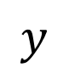
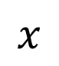



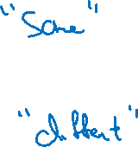
Face verification supervised learning
$$x$$
$$y$$
$$1$$
$$0$$
$$0$$
$$1$$
[Taigman et. al., 2014. DeepFace closing the gap to human level performance]

